Slide 1
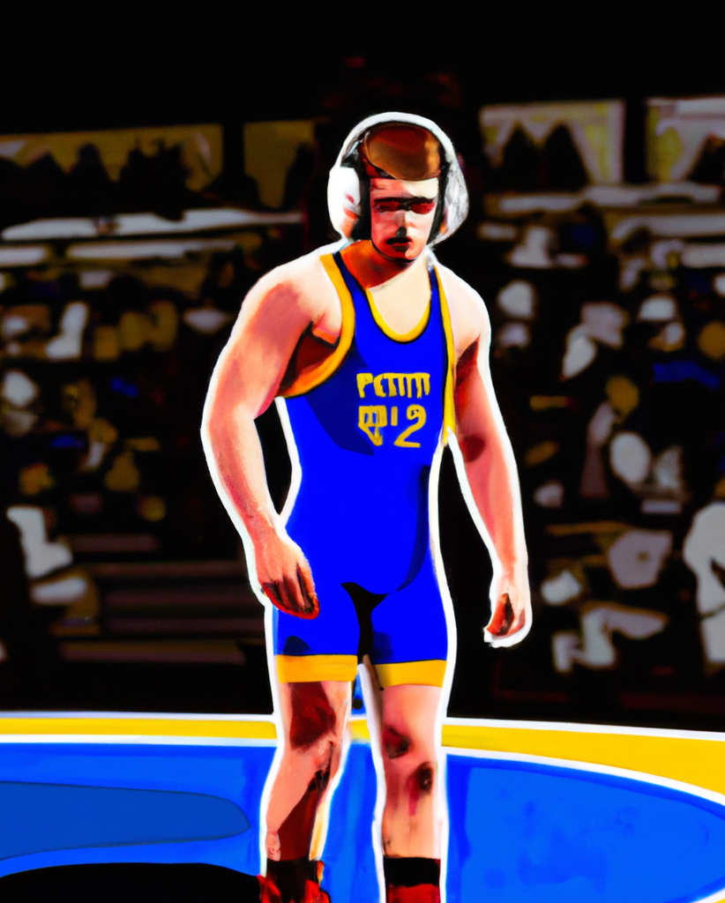
.
"Johnson's Proven Success in the EPC: A National Leader in High School Athletics"
.
• Johnson was a member of Freedom High School's football, track and field, and wrestling teams
• All three teams competed in the Eastern Pennsylvania Conference (EPC), one of the nation's best
• The EPC wrestling programs have been ranked best in the nation by WIN magazine and have been recognized as "among the nation's best in the sport for nearly three decades"
• Johnson had the opportunity to face some of the best high school wrestlers in the nation

Slide 2
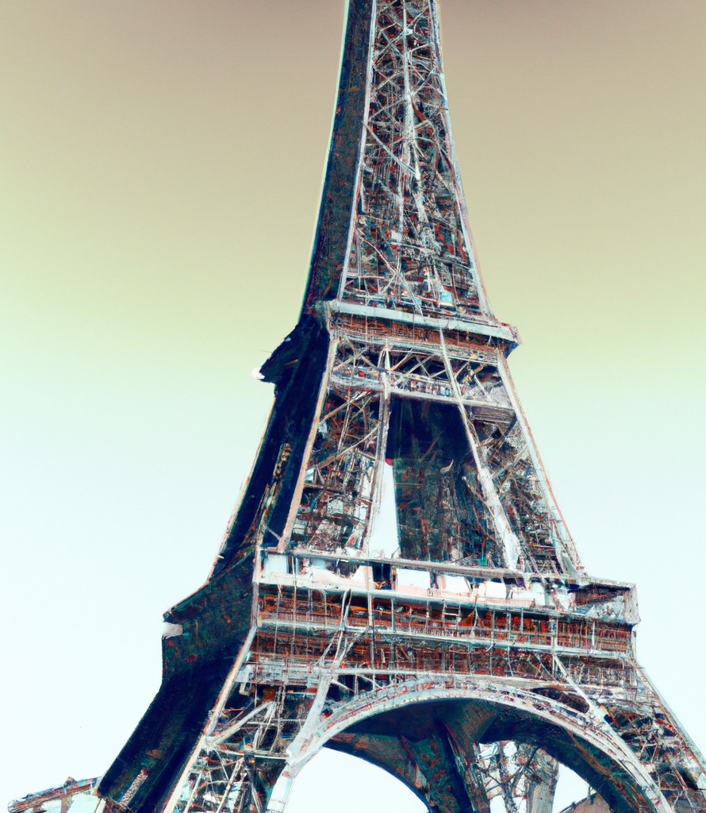
"The Iconic Eiffel Tower: A Celebration of French History and Culture"
- Built from 1887 to 1889
- Centrepiece of the 1889 World's Fair
- Nicknamed "La dame de fer"
- Global cultural icon of France
- Most visited monument with an entrance fee in the world
- Designated a monument historique in 1964
- Part of a UNESCO World Heritage Site ("Paris, Banks of the Seine") in 1991

Slide 3
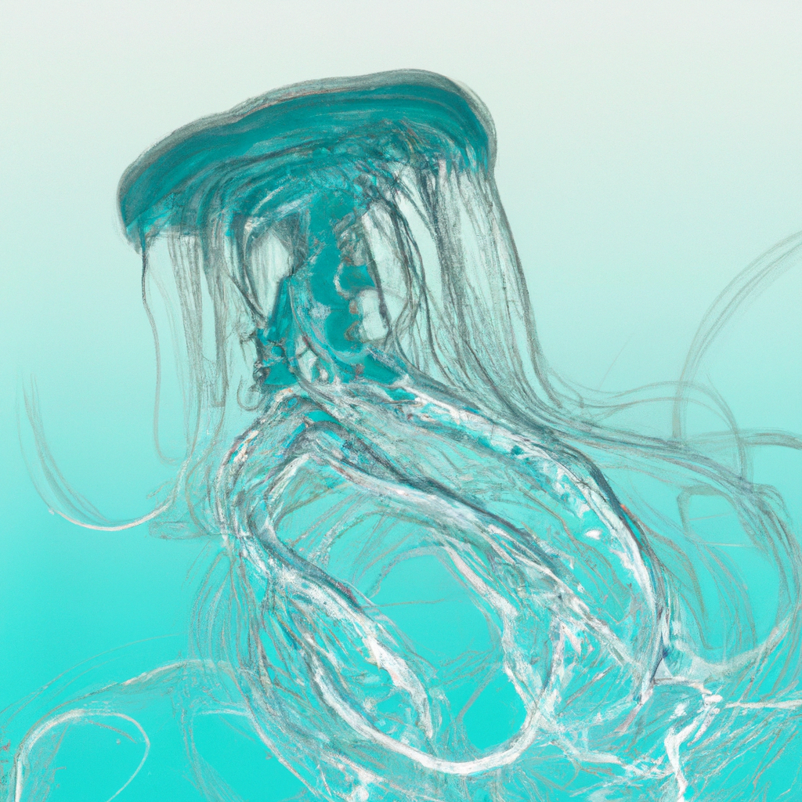
"Jellyfish: Masters of the Marine Environment"
• Jellyfish and sea jellies are members of the subphylum Medusozoa
• They are mostly free-swimming marine animals with umbrella-shaped bells and trailing tentacles
• The bell can pulsate to provide propulsion
• The tentacles are armed with stinging cells
• Jellyfish have a complex life cycle, with a sexual and a sedentary polyp phase
• The medusa phase produces planula larvae which disperse and enter the polyp phase
• The polyp phase reaches sexual maturity before becoming a medusa again

